Slide 1

PESANTE ENGINEERING PRIVATE LIMITED
Registered Office:
Bhojpur Colony, Chota Gamharia,
Near Shiv Mandir, Saraikela.
Pin – 833219, Jharkhand.
Mobile Nos. : +91-986783940
: +91-9334248498
E-mail : customerservice@pesante.co.in
Website : www.pesante.co.in

Slide 2
AN OVERVIEW
Founded:
2012
i. All kinds of Civil Construction & Painting work.
ii. All kinds of Furniture, Electrical , Electro-
Mechanical, ACP Cladding, Contractors
& General order Suppliers
iii. Civil Interiors decoration & renovations)
Business Type:
No. of Employees:
35 Employees
Other WorkingAreas:
Designing, consulting, Beautification, Re- moulding and hard core technical solution services.

Slide 3
Our Mission
“End to End Customer Solution”
On time delivery,
Guaranteed performance and
Offering end-to-end solutions to our customer”
We are committed to provide a satisfactory deliverance as per the customer desire and ensure to reach our valuable clients expectations by maintaining a high level of Safety and Quality.
We Believes in :
delivering and upgrading our employees professional skills through advance training opportunities.
Bringing new product & services in order have a continuous improvements.
creating friendly environment and a honest relationship with all of our clients & partners.

Slide 4
Our Vision
“To be recognized as a leading Organization
To provide and develop strong leadership with integrity.
T o constantly strive for continuity of works, taking pride in our aim of delivering all projects safely,
and on time.
To respect the well-being of our workers and protect the environment, maintaining our „zero harm‟ record.
To promote continual improvement of our Integrated Management System, adopting innovations and efficiencies without compromising environmental or safety standards.
To recognise and encourage our employees, providing skills development opportunities to help them develop in their careers.

Slide 5
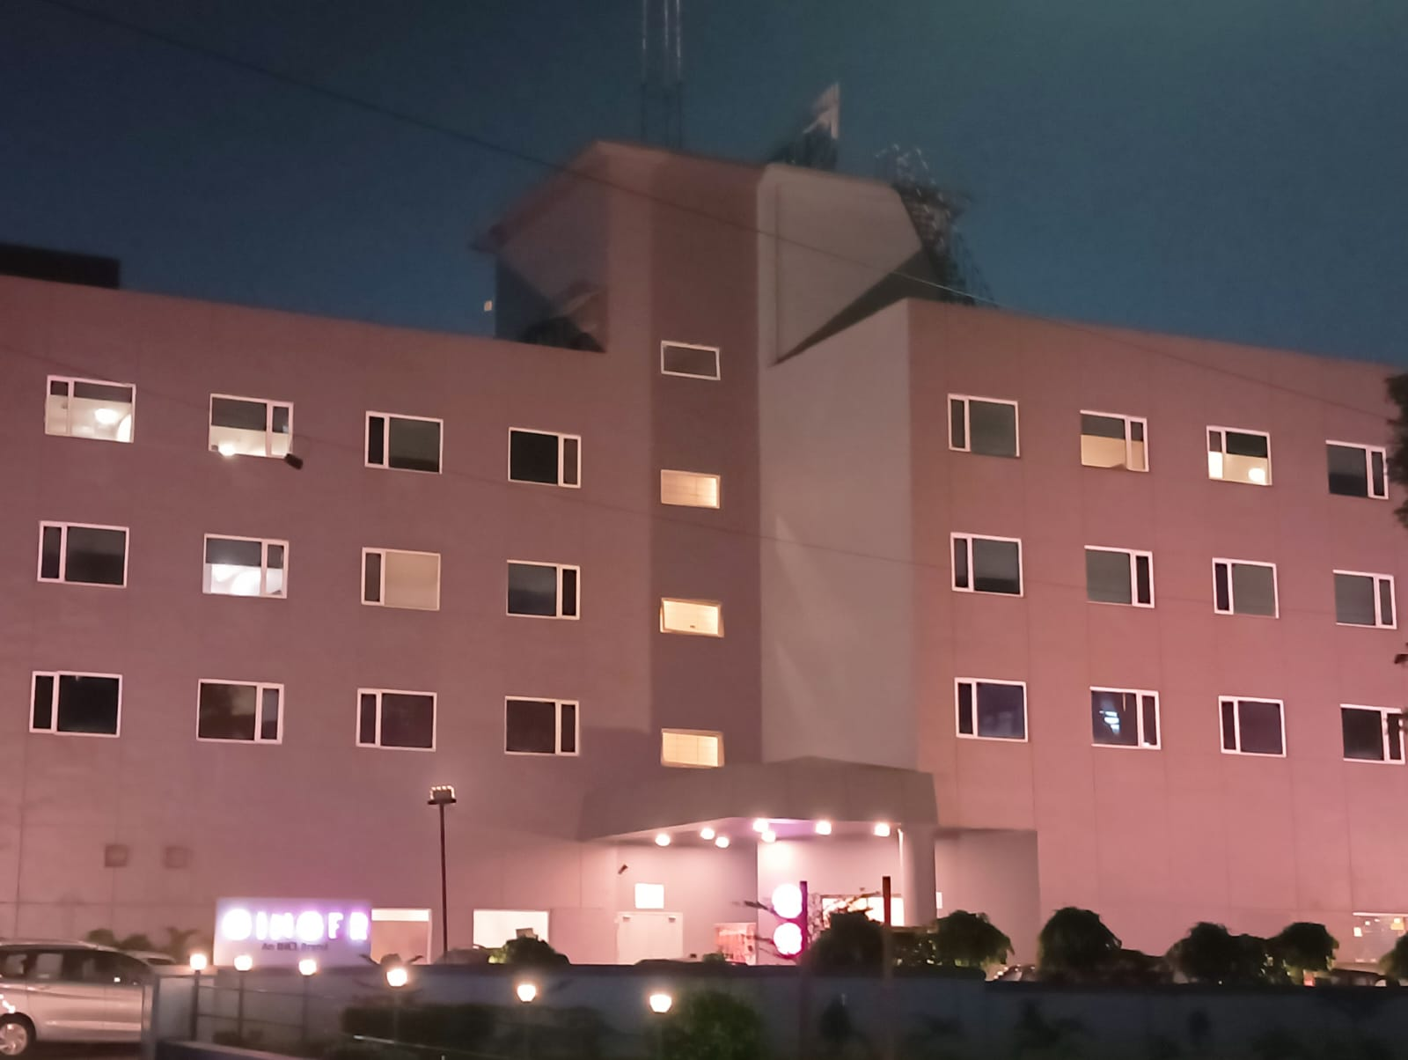
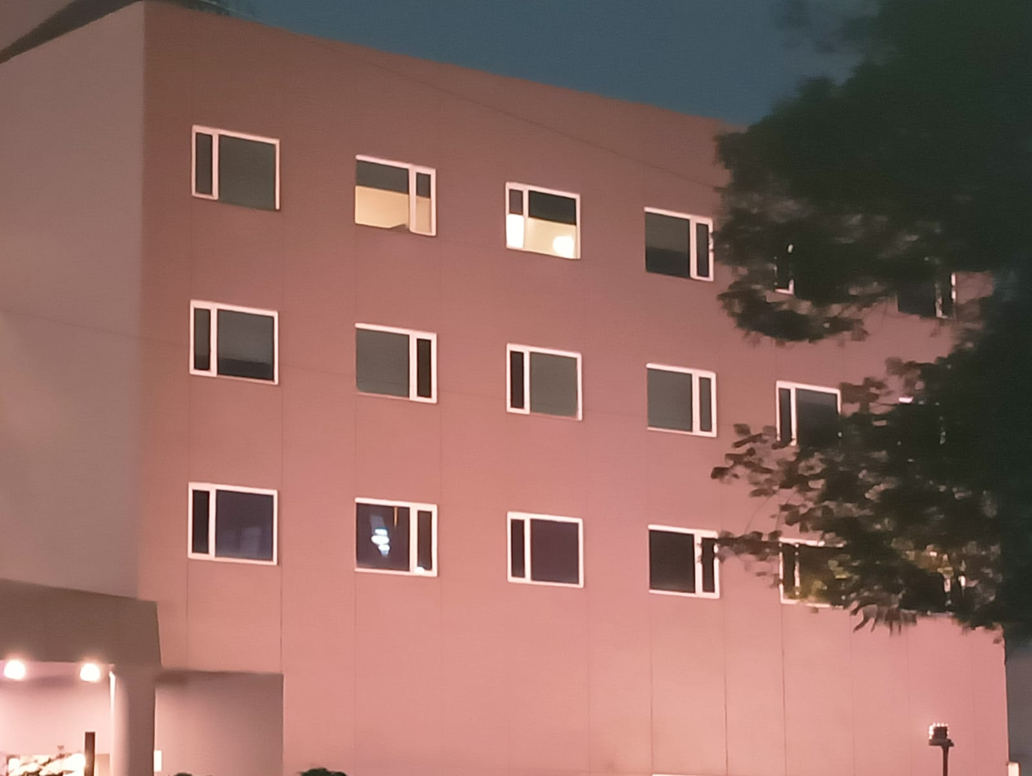
A complete painting solution of hotel ginger, jamshedpur

Slide 6
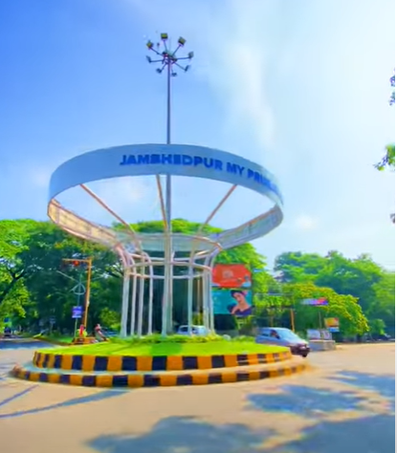
ACP WORK Of I love Jamshedpur, beldih church chowk

Slide 7
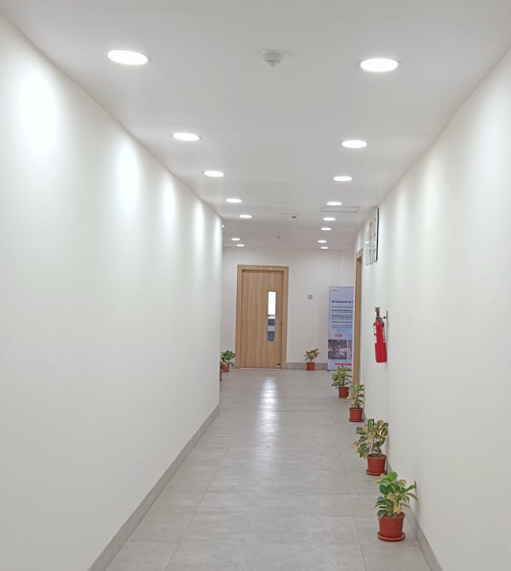
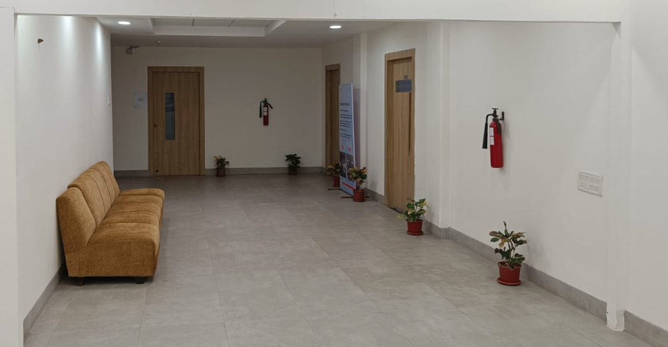
Flooring work at Commercial centre 3rd floor, general office, jamshedpur

Slide 8
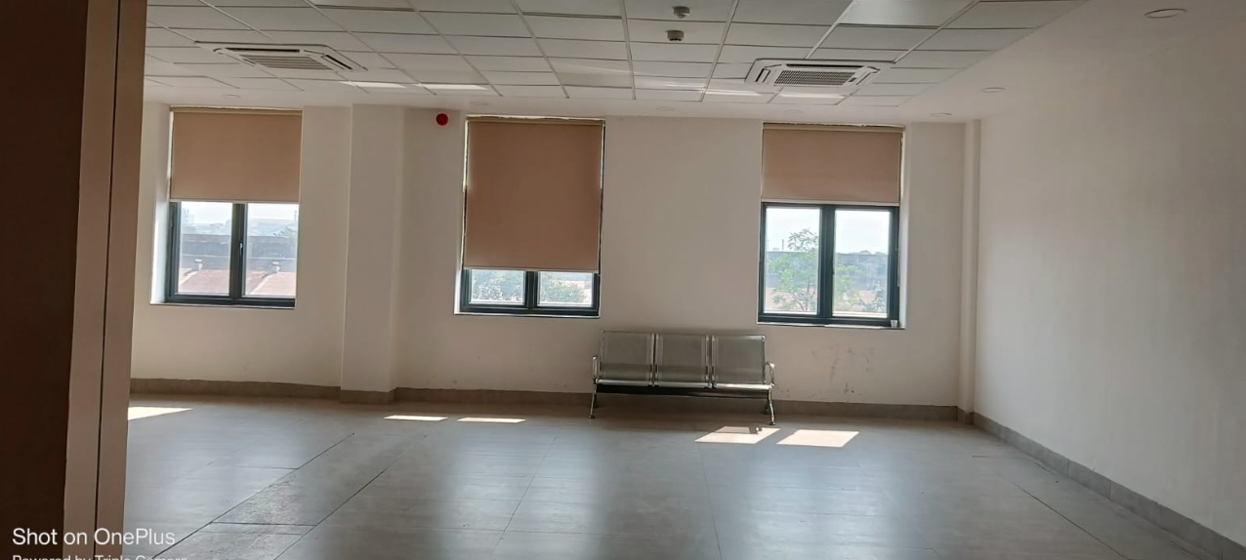
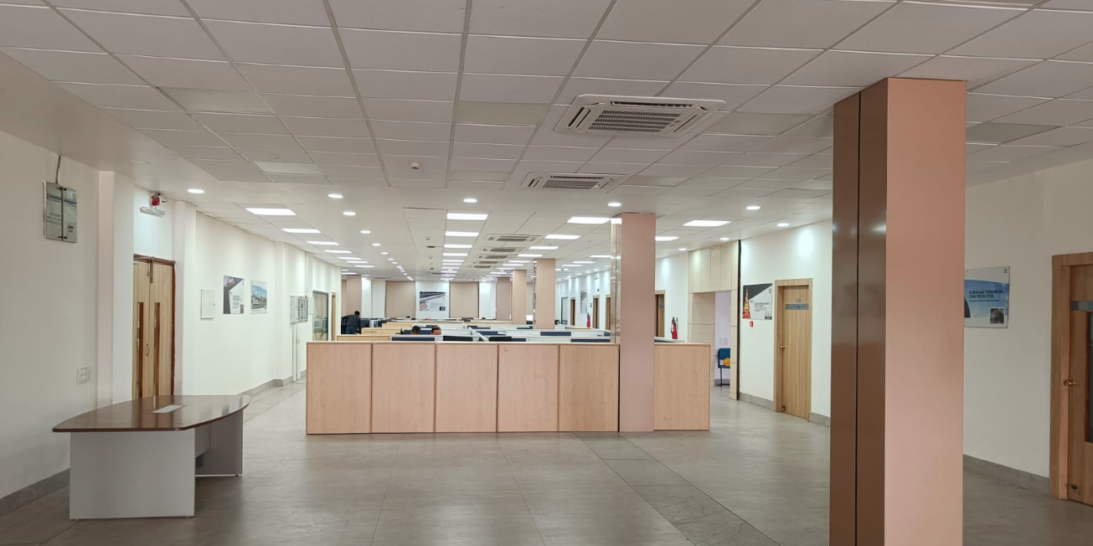
Flooring, False ceiling, window and cladding work at Commercial centre 3rd floor, general office, jamshedpur

Slide 9
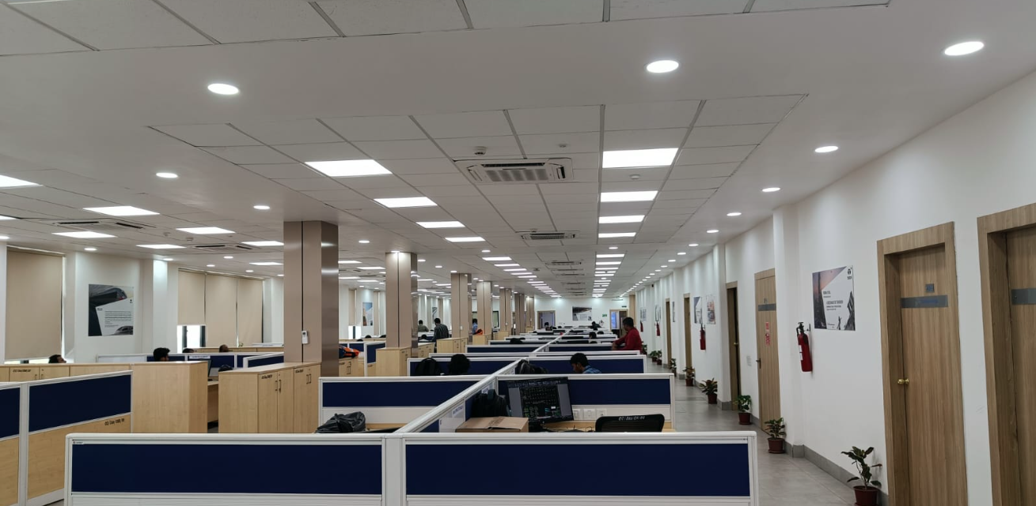
False ceiling and cladding work at Commercial centre 3rd floor, general office, jamshedpur

Slide 10
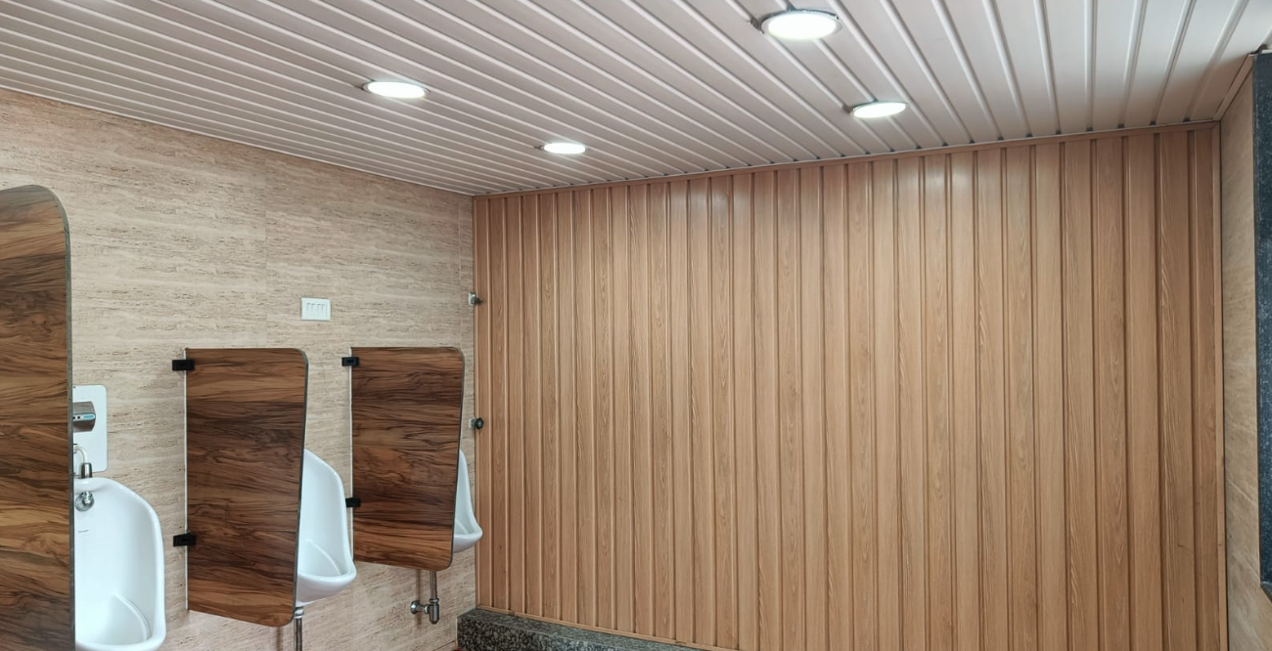
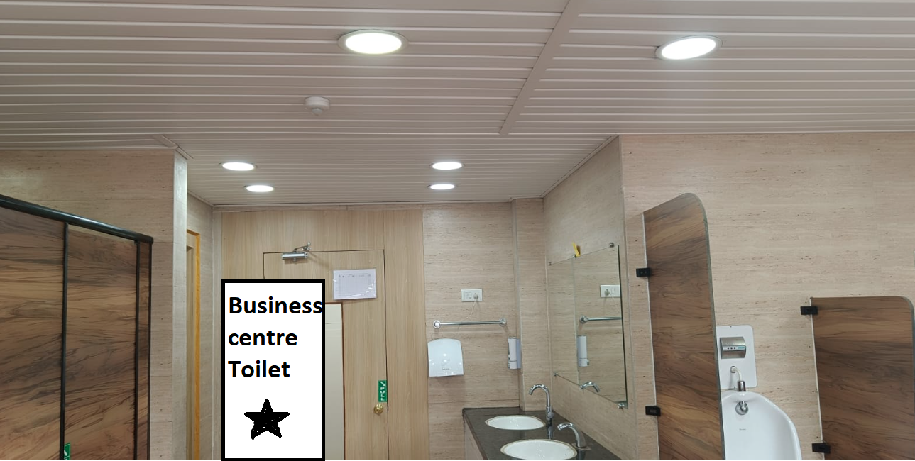
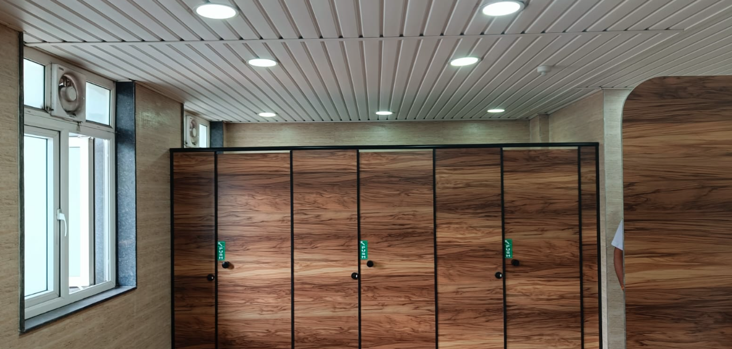
Business centre Toilet at business centre ground floor, general office, jamshedpur

Slide 11
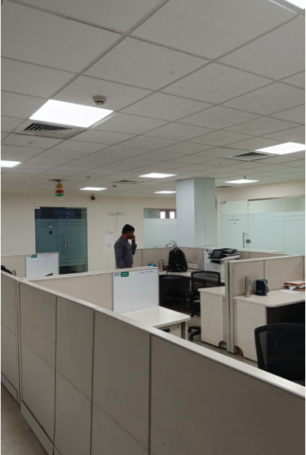
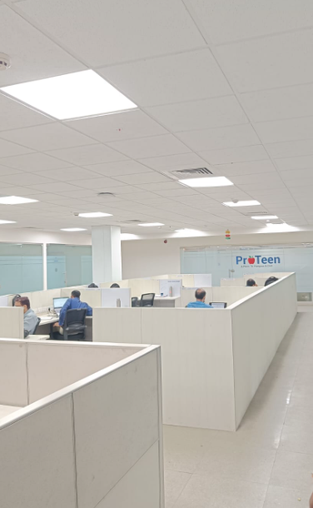
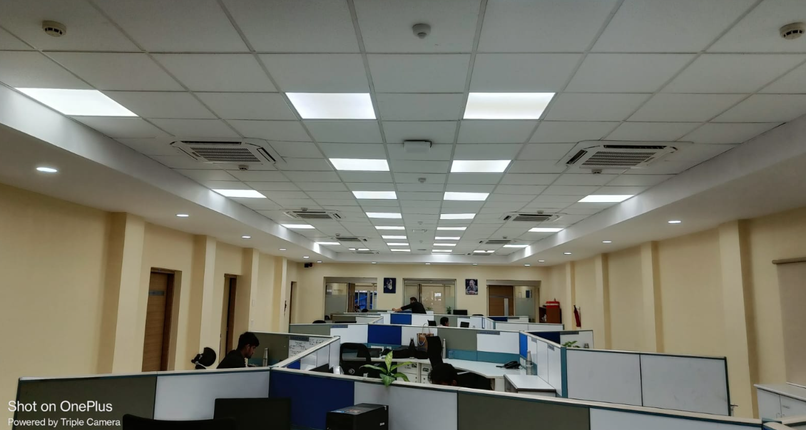
False ceiling and floor tiles work at business centre 3rd floor, general office, jamshedpur

Slide 12


